Slide 1
Tabulation Method
The Quine-McCluskey Method

Slide 2
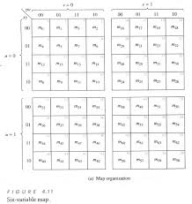
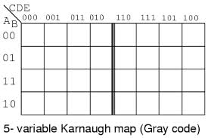
K-map going big!
6 variable k-map

Slide 3
K-map works well upto 4 variable, but when number of variable is more than that trouble starts as it gets difficult to recognize patters leading to wrong selection
Quine McCluskey method or the tabulation method is more systematic and works well for any number of variable

Slide 4
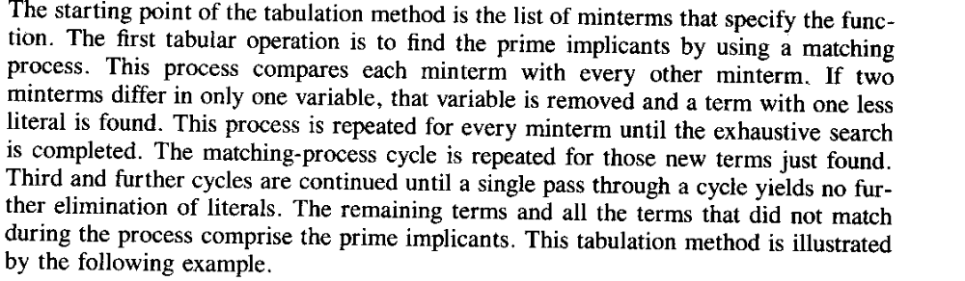

Slide 5
Part 1:Determination of the prime implicant
Forming the tabulation method

Slide 6
Example
F(w,x,y,z)=∑(1,4,6,7,8,9,10,11,15)
F={0001,0100,0110,0111,1000,1001,1010,1011,1111}
Step 1: group the minterms based on the no. of ‘1’s in them
Group A: single ‘1’: {0001,0100,1000}
Group B: two ‘1’s: {0110,1001,1010}
Group C: three ‘1’s: {0111,1011}
Group D:four ‘1’s: {1111}

Slide 7
 | Step 1
1 | 0001
4 | 0100
8 | 1000
6 | 0110
9 | 1001
10 | 1010
7 | 0111
11 | 1011
15 | 1111

Slide 8
Step 2: Any 2 minterm that differ by 1 variable is combined and the different variable is removed.The minterms of a group is compared with minterms of immediate next group (this is because 2 term differing by more than 1 bit cannot match). If 2 matching minterms are found, a ‘√’ (tick) is place besides them

Slide 9
 | Step 1 | Step 2
1 | 0001 | (1,9) | _001
4 | 0100 | (4,6) | 01_ 0
8 | 1000 | (8,9) | 100_
 |  | (8,10) | 10_0
6 | 0110 | (6,7) | 011_
9 | 1001 | (9,11) | 10_1
10 | 1010 | (10,11) | 101_
7 | 0111 | (7,15) | _111
11 | 1011 | (11,15) | 1_11
15 | 1111

Slide 10
Step 3:
Terms from step 2 has 3 options. ‘1’ means variable is unprimed, ‘0’ means variable is primed and ‘_’ means variable is not included in the term.
Now compare terms only if they have ‘_’ in the same position. Once two term match place a ‘√’ beside each

Slide 11
 | Step 1 | Step 2 |  |  | Step 3
1 | 0001 | √ | (1,9) | _001 |  | (8,9,10,11) | 10_ _
4 | 0100 | √ | (4,6) | 01_ 0 |  | (8,9,10,11) | 10_ _
8 | 1000 | √ | (8,9) | 100_ | √
 |  |  | (8,10) | 10_0 | √
6 | 0110 | √ | (6,7) | 011_
9 | 1001 | √ | (9,11) | 10_1 | √
10 | 1010 | √ | (10,11) | 101_ | √
7 | 0111 | √ | (7,15) | _111
11 | 1011 | √ | (11,15) | 1_11
15 | 1111 | √

Slide 12
Prime Implicant
The remaining term ( those without ‘√’) in Step 2 and the terms from Step 3 are called the prime implcants. These terms are candidates suitable for forming the simplified form of the expression
Here prime implicants are:
(1,9) | _001 | X’Y’Z
(4,6) | 01_0 | W’XZ’
(6,7) | 011_ | W’XY
(7,15) | _111 | XYZ
(11,15) | 1_11 | WYZ
(8,9,10,11) | 10_ _ | WX’

Slide 13
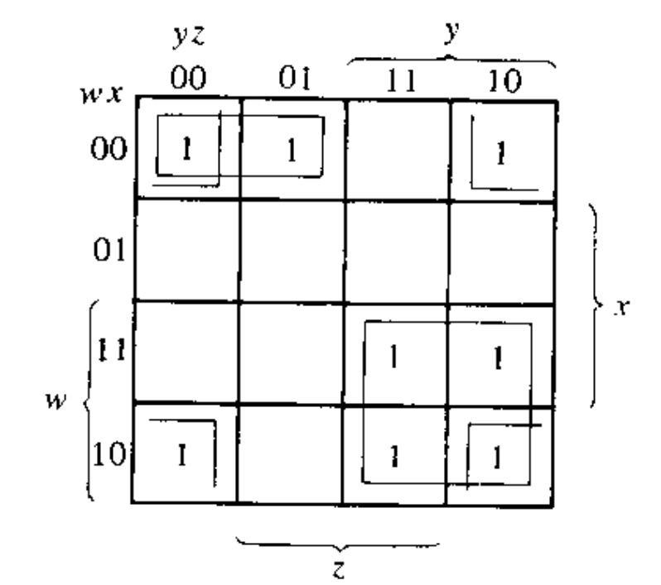
K-MAP using prime implicant shows that it can be further simplified to
F(w,x,y,z)= X’Y’Z+W’XZ’+XYZ+WX’
To achieve further simplification we need to
find the essential prime implicant and
remove the domination rows and dominated
columns.

Slide 14
Part 2: Selection of prime implicants- the setup
Optimizing the tabular method

Slide 15
Step 4: Remove rows with single ‘1’. Their corresponding columns are essential prime implicants. That is they will be in the simplified form of expression. . If any rows having more than ‘1’s belong to the essential implicant rows, remove them as well before going to next step For next step, take the remaining part of the table
Prime Impl. minterm | X’Y’Z | W’XZ’ | W’XY | XYZ | WYZ | WX’
0001 | 1
0100 |  | 1
0110 |  | 1 | 1
0111 |  |  | 1 | 1
1000 |  |  |  |  |  | 1
1001 | 1 |  |  |  |  | 1
1010 |  |  |  |  |  | 1
1011 |  |  |  |  | 1 | 1
1111 |  |  |  | 1 | 1
Essential
Prime implicant
F(W,X,Y,Z)= X’Y’Z+W’XZ’+WX’+ (SOME MORE FROM STEP 5)…SO LETS LOOK AT STEP 5

Slide 16
Step 4: Remove rows with single ‘1’. Their corresponding columns are essential prime implicants. That is they will be in the simplified form of expression. If any rows having more than ‘1’s belong to the essential implicant rows, remove them as well before going to next step For next step, take the remaining part of the table
Prime Impl. minterm | X’Y’Z | W’XZ’ | W’XY | XYZ | WYZ | WX’
0001 | 1
0100 |  | 1
0110 |  | 1 | 1
0111 |  |  | 1 | 1
1000 |  |  |  |  |  | 1
1001 | 1 |  |  |  |  | 1
1010 |  |  |  |  |  | 1
1011 |  |  |  |  | 1 | 1
1111 |  |  |  | 1 | 1
F(W,X,Y,Z)= X’Y’Z+W’XZ’+WX’+ (SOME MORE FROM STEP 5)…SO LETS LOOK AT STEP 5

Slide 17
Step 5: Find and remove dominating rows (row which have same and more ‘1’s as neighboring row) and dominated column (columns whose ‘1’s are in common with another column that has same and more ‘1’s)
 | W’XY | XYZ | WYZ
0111 | 1 | 1
1111 |  | 1 | 1
Essentia-l P.I.
Here there is no dominating row. But there is dominated column. Like ‘XYZ’ column has all the ‘1’s of both its left and right side neighboring row . So we remove row W’XY and WYZ as they are dominated by XYZ.
So solution is
F(W,X,Y,Z)= X’Y’Z+W’XZ’+WX’+XYZ
This matched the result from K-MAP!

Slide 18
Example 2
F(a,b,c,d)=∑m(2,5,6,11,12,14,15)+ ∑d(0,3,4)
Note: avoid the don’t care terms in the set-up(optimization) phase.

Slide 19
 | Step 1 | Step 2 |  |  |  | Step 3
0 | 0000 | √ | (0,2) | 00-0 | √ | (0,2,4,6) | 0--0
 |  |  | (0,4) | 0-00 | √ | (0,4,2.6) | 0--0
2 | 0010 | √ | (2,3) | 001- |  | (4,6,12,14) | -1-0
4 | 0100 | √ | (2,6) | 0-10 | √ | (4,12,6,14) | -1-0
 |  |  | (4,5) | 010-
 |  |  | (4,6) | 01-0 | √
 |  |  | (4,12) | -100 | √
3 | 0011 | √ | (3,11) | -011
5 | 0101 | √ | (6,14) | -011 | √
6 | 0110 | √ | (12,14) | 11-0 | √
12 | 1100 | √
11 | 1011 | √ | (11,15) | 1-11
14 | 1110 | √ | (14,15) | 111-
15 | 1111 | √

Slide 20
Don’t care terms are avoided here.
 | A’D’ | BD’ | A’B’C | A’BC’ | B’CD | ACD | ABC
0010 | 1 |  | 1
0101 |  |  |  | 1
0110 | 1 | 1
1011 |  |  |  |  | 1 | 1
1100 |  | 1
1110 |  | 1 |  |  |  |  | 1
1111 |  |  |  |  |  | 1 | 1
F(W,X,Y,Z)= BD’+A’BC’+ (SOME MORE FROM STEP 5)…SO LETS LOOK AT STEP 5

Slide 21
 | A’D’ | A’B’C | B’CD | ACD | ABC
0010 | 1 | 1
1011 |  |  | 1 | 1
1111 |  |  |  | 1 | 1
Essential P.I.
A’B’C is dominated by A’D’ column
BC’D and ABC columns are dominated by ACD
So solution is
F(W,X,Y,Z)= BD’+A’BC’+ A’D’+ ACD

Slide 22
Try it yourself
F(w,x,y,z)=∑(0,1,2,8,10,11,14,15)

Slide 23
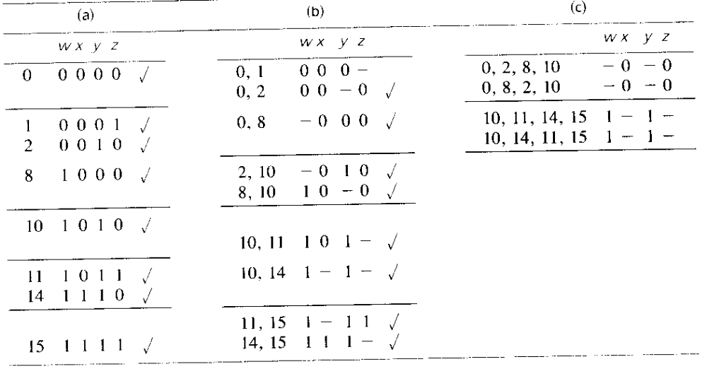
Solution

Slide 24
Prime implicant optimization
F=w’x’y’+x’z’+wy
All rows have single ‘1’, so all are essential prime implicant hence no further optimization can be done. Answer is:
F=w’x’y’+x’z’+wy
 | W’X’Y’ | X’Z’ | WY
0000 | 1 | 1
0001 | 1
0010 |  | 1
1000 |  | 1
1010 |  | 1 | 1
1011 |  |  | 1
1110 |  |  | 1
1111 |  |  | 1

